Slide 1
Presentation by: -Sourabh 2K18/CO/355 -Tanyam Singhal 2K18/CO/371
Hyper-Parameter Optimization using PSO on Machine Learning Models
SWARM and Evolutionary Computing (CO-423)
Under the supervision of Ms. Nishtha Ahuja

Slide 2

To fit a machine learning model into different problems, its hyper-parameters must be tuned. Selecting the best hyper-parameter configuration for machine learning models has a direct impact on the model's performance. In the project, we have tried optimizing the hyper-parameters of common machine learning models like random forest, SVM and KNN are studied using particle swarm optimization.
Aim

Slide 3
Hyper-parameters are the parameters that are used to either configure a ML model (e.g., the penalty parameter C in a support vector machine, and the learning rate to train a neural network) or to specify the algorithm used to minimize the loss function (e.g., the activation function and optimizer types in a neural network, and the kernel type in a support vector machine).
Hyper-Parameters

Slide 4
The process of designing the ideal model architecture with an optimal hyper-parameter configuration is named hyper-parameter tuning.
Manual testing is a traditional way to tune hyper-parameters However, manual tuning is ineffective for many problems due to certain factors, including a large number of hyper-parameters, complex models, time consuming model evaluations, and non-linear hyper-parameter interactions.
Hyper-Parameter
Tuning

Slide 5
It reduces the human effort required, since many ML developers spend considerable time tuning the hyper-parameters
It improves the performance of ML models. Many ML hyper-parameters have different optimums to achieve best performance in different datasets or problems.
3. It makes the models and research more reproducible. using a same HPO method on different ML algorithms also helps to determine the most suitable ML model for a specific problem.
Why
Hyper-Parameter
Optimization ?

Slide 6
HPO algorithms:
Grid search,
Random search,
Hyperband,
Bayesian Optimization with Gaussian Processes (BO-GP),
Bayesian Optimization with Tree-structured Parzen Estimator (BO-TPE),
Particle swarm optimization (PSO),
Genetic algorithm (GA).
Hyper-Parameters
Optimization
Techniques

Slide 7
Particle swarm optimization (PSO): Each particle in a swarm communicates with other particles to detect and update the current global optimum in each iteration until the final optimum is detected.
Advantages:
Efficient with all types of HPs.
Enable parallelization.
Disadvantages:
Require proper initialization.
HPO
Algorithm used

Slide 8
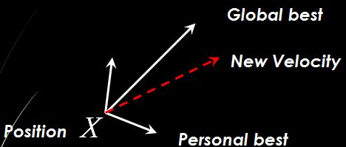
The basic concept of PSO lies in accelerating each particle toward its pbest(the best solution achieved so far by that particle) and the gbest(the best value obtained so far by any particle) locations, with a
random weighted acceleration at each time.
PSO uses a number of agents, i.e., particles, that constitute a swarm flying in the search space looking for the best solution.
Each particle is treated as a point (candidate solution) in a N-dimensional space which adjusts its “flying” according to its own flying experience as well as the flying experience of other particles.
Particle Swarm
Optimization (PSO)

Slide 9
Each particle tries to modify its position X using the following formula:
1. X (t+1) = X(t) + V(t+1)
2. V(t+1) = wV(t) + c₁ ×rand ( ) × ( X_{pbest} - X(t)) + c₂ ×rand ( ) × ( X_{gbest} - X(t))
The Search
Scheme
V(t) | velocity of the particle at time t
X(t) | Particle position at time t
w | Inertia weight
c₁ , c₂ | learning factor or accelerating factor
rand | uniformly distributed random number between 0 and 1
X_{pbest} | particle’s best position
X_{gbest} | global best position

Slide 10
It is easier to implement PSO, since PSO does not have certain additional operations like crossover and mutation.
In GA, all chromosomes share information with each other, so the entire population moves uniformly toward the optimal region; while in PSO, only information on the individual best particle and the global best particle is transmitted to others, which is a one-way flow of information sharing, and the entire search process follows the direction of the current optimal solution.
The computational complexity of PSO algorithm is O(nlogn). In most cases, the convergence speed of PSO is faster than of GA.
PSO v/s GA

Slide 11
Start
Initialize particles with random position and zero velocity
The Algorithm
Evaluate fitness value
Compare & update fitness value with pbest and gbest
YES
Stop?
End
NO
Update velocity and position

Slide 12
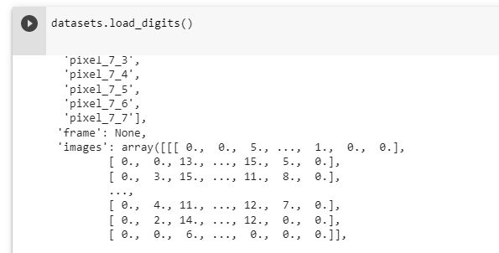
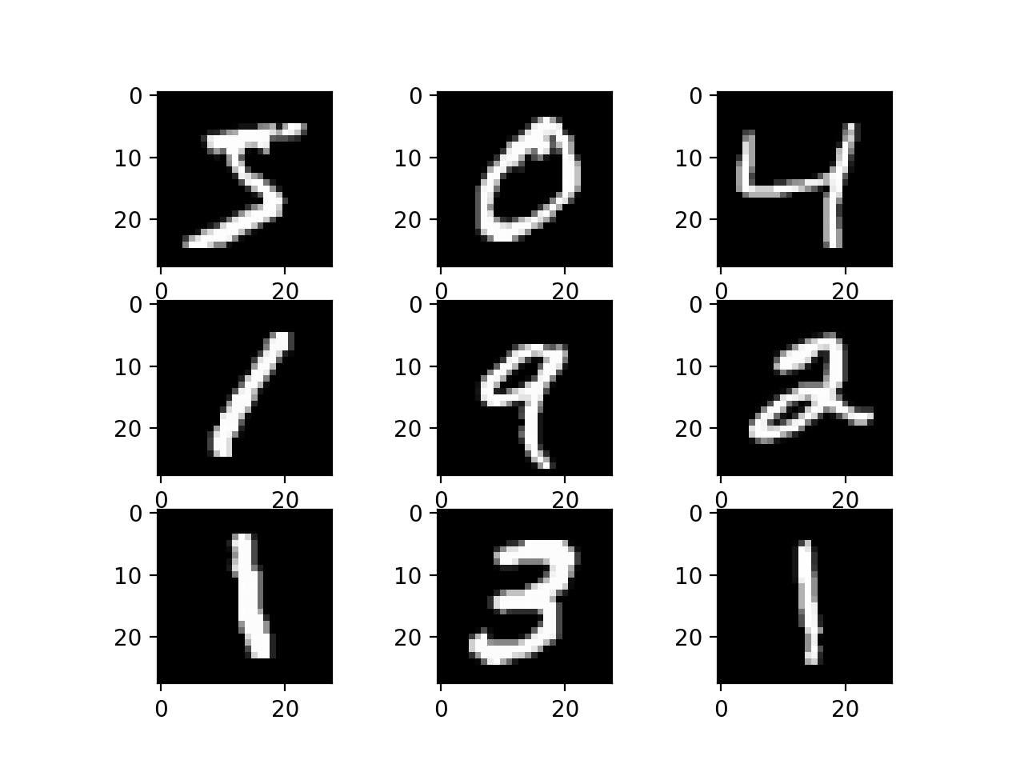
Dataset used is MNIST from sklearn, The MNIST dataset is an acronym that stands for the Modified National Institute of Standards and Technology dataset. It is a dataset of 60,000 small square 28×28 pixel grayscale images of handwritten single digits between 0 and 9.
DATASET

Slide 13
The following three Machine Learning algorithms were employed for the purpose:
Random forest (RF)
Support vector machine (SVM)
K-nearest neighbor (KNN)
ML Algorithms
Used

Slide 14
Performance Metric used was classification accuracy Classification accuracy. It is a metric that summarizes the performance of a classification model as the number of correct predictions divided by the total number of predictions. It is easy to calculate and intuitive to understand.
Performance
Metrics

Slide 15


For classifiers with default hyperparameters
Results
Random Forest
2. SVM
3. KNN

Slide 16


For classifiers after optimization
Results
Random Forest
2. SVM
3. KNN

Slide 17
L. Yang and A. Shami, “On hyperparameter optimization of machine learning algorithms: Theory and practice,” Neurocomputing, vol. 415, pp. 295–316, 2020, doi: https://doi.org/10.1016/j.neucom.2020.07.061.
Feurer, Matthias, and Frank Hutter. "Hyperparameter optimization." Automated machine learning. Springer, Cham, 2019. 3-33.
Reference

Slide 18

-SOURABH
2K18/CO/355
-Tanyam Singhal
2K18/CO/371

